Slide 1
Getting started with Python Programming
Presented by Adam Parrish August 25, 2021
Notes:
Raise your hand if
You have ever programmed for fun or profit before
You have take a course to learn about any programming language
You know a little bit of Python - maybe you'd be able to help a colleague today

Slide 2


Slide 3
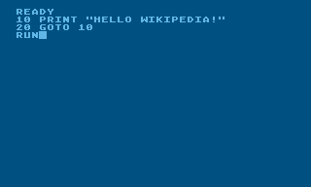
First Steps in Programming
How I got into this….

Slide 4
Getting Started with Python Programming
01 Overview
My Goal
My Promise
Overview of Today
02 REPL Programming
Programming Styles
The Environment
Writing some code
03 Jupyter Notebooks w/ Python
Hello world Jupyter Style
Yedioth and NewsVendor
Portfolio Analysis Demo

Slide 5
Make you dangerous at programming

Slide 6
My promise
Get you on your way with programming
Remove hurdles
(If I’m lucky) Spark Interest

Slide 7
Overview
REPL Programming (Dip your toes)
Jupyter Notebooks with Python
More Examples of Jupyter and Python

Slide 8
REPL

Slide 9
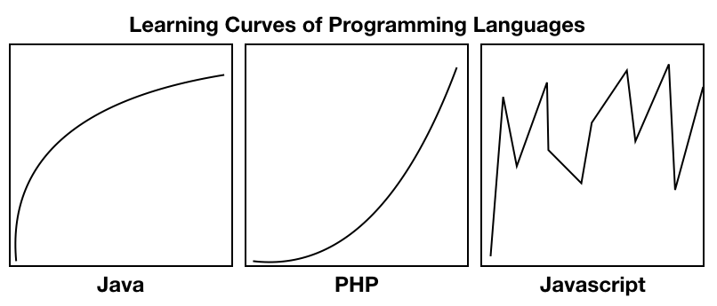
Learning programming

Slide 10
H4x0ring (Paradigms of Programming)
Imperative (Changes State)
Object Oriented (Java, .NET)
Procedural (Fortran, Perl, Python)
Declarative (Describes how to compute)
Functional (Haskell, Scheme, Lisp, JavaScript)
Source: https://en.wikipedia.org/wiki/Programming_paradigm

Slide 11
REPL
Read Eval Print Loop
Online REPL: https://replit.com/
Let’s write some code

Slide 12
Jupyter Notebooks

Slide 13
Bañotime?
Sinovsky says you need a quick break?

Slide 14
Jupyter Notebooks
Open up Anaconda Navigator
Fire up (Launch) Jupyter
Navigate to http://localhost:8888/

Slide 15
NewsVendor with Yedioth
We’ll walk through the Yedioth Exploration
Plot some data
Compute the ideal solution for
Perfect Pooling
Pooled By Sales Agent

Slide 16
Portfolio Analysis with MPT
Back to DMD
Remember the ideal allocation between 2 stocks?
Let’s compute that!

Slide 17
Wrap Up

Slide 18
Revisit the Promise
Do you feel dangerous?
At least annoying to those you may employ in the future?
Intrigued?

Slide 19
THANK YOU
MIT Sloan School of Management
50 Memorial Drive, E52-359 Cambridge, MA 02142 USA
617-258-5434 sfadmissions.mitsloan@mit.edu
#MyMITSloan mitsloan.mit.edu

